Slide 1
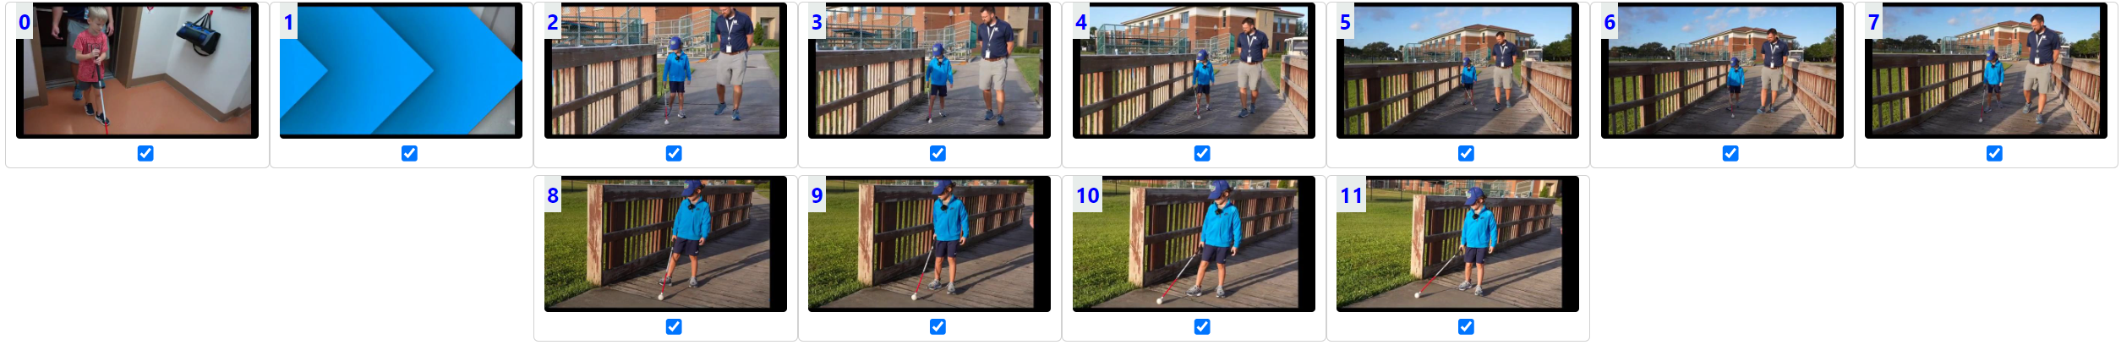

Slide 2
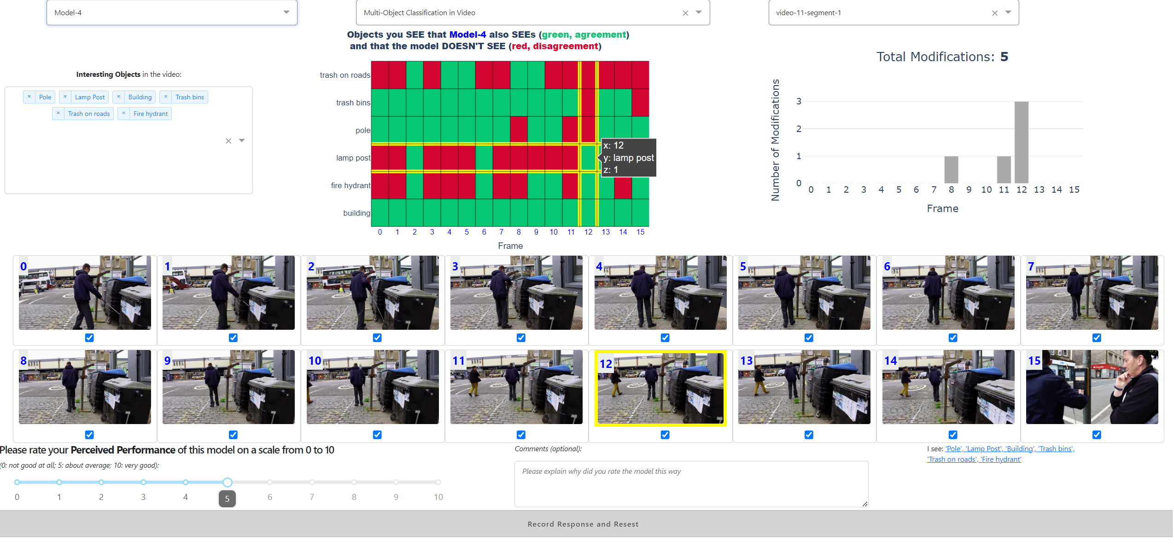

Slide 3
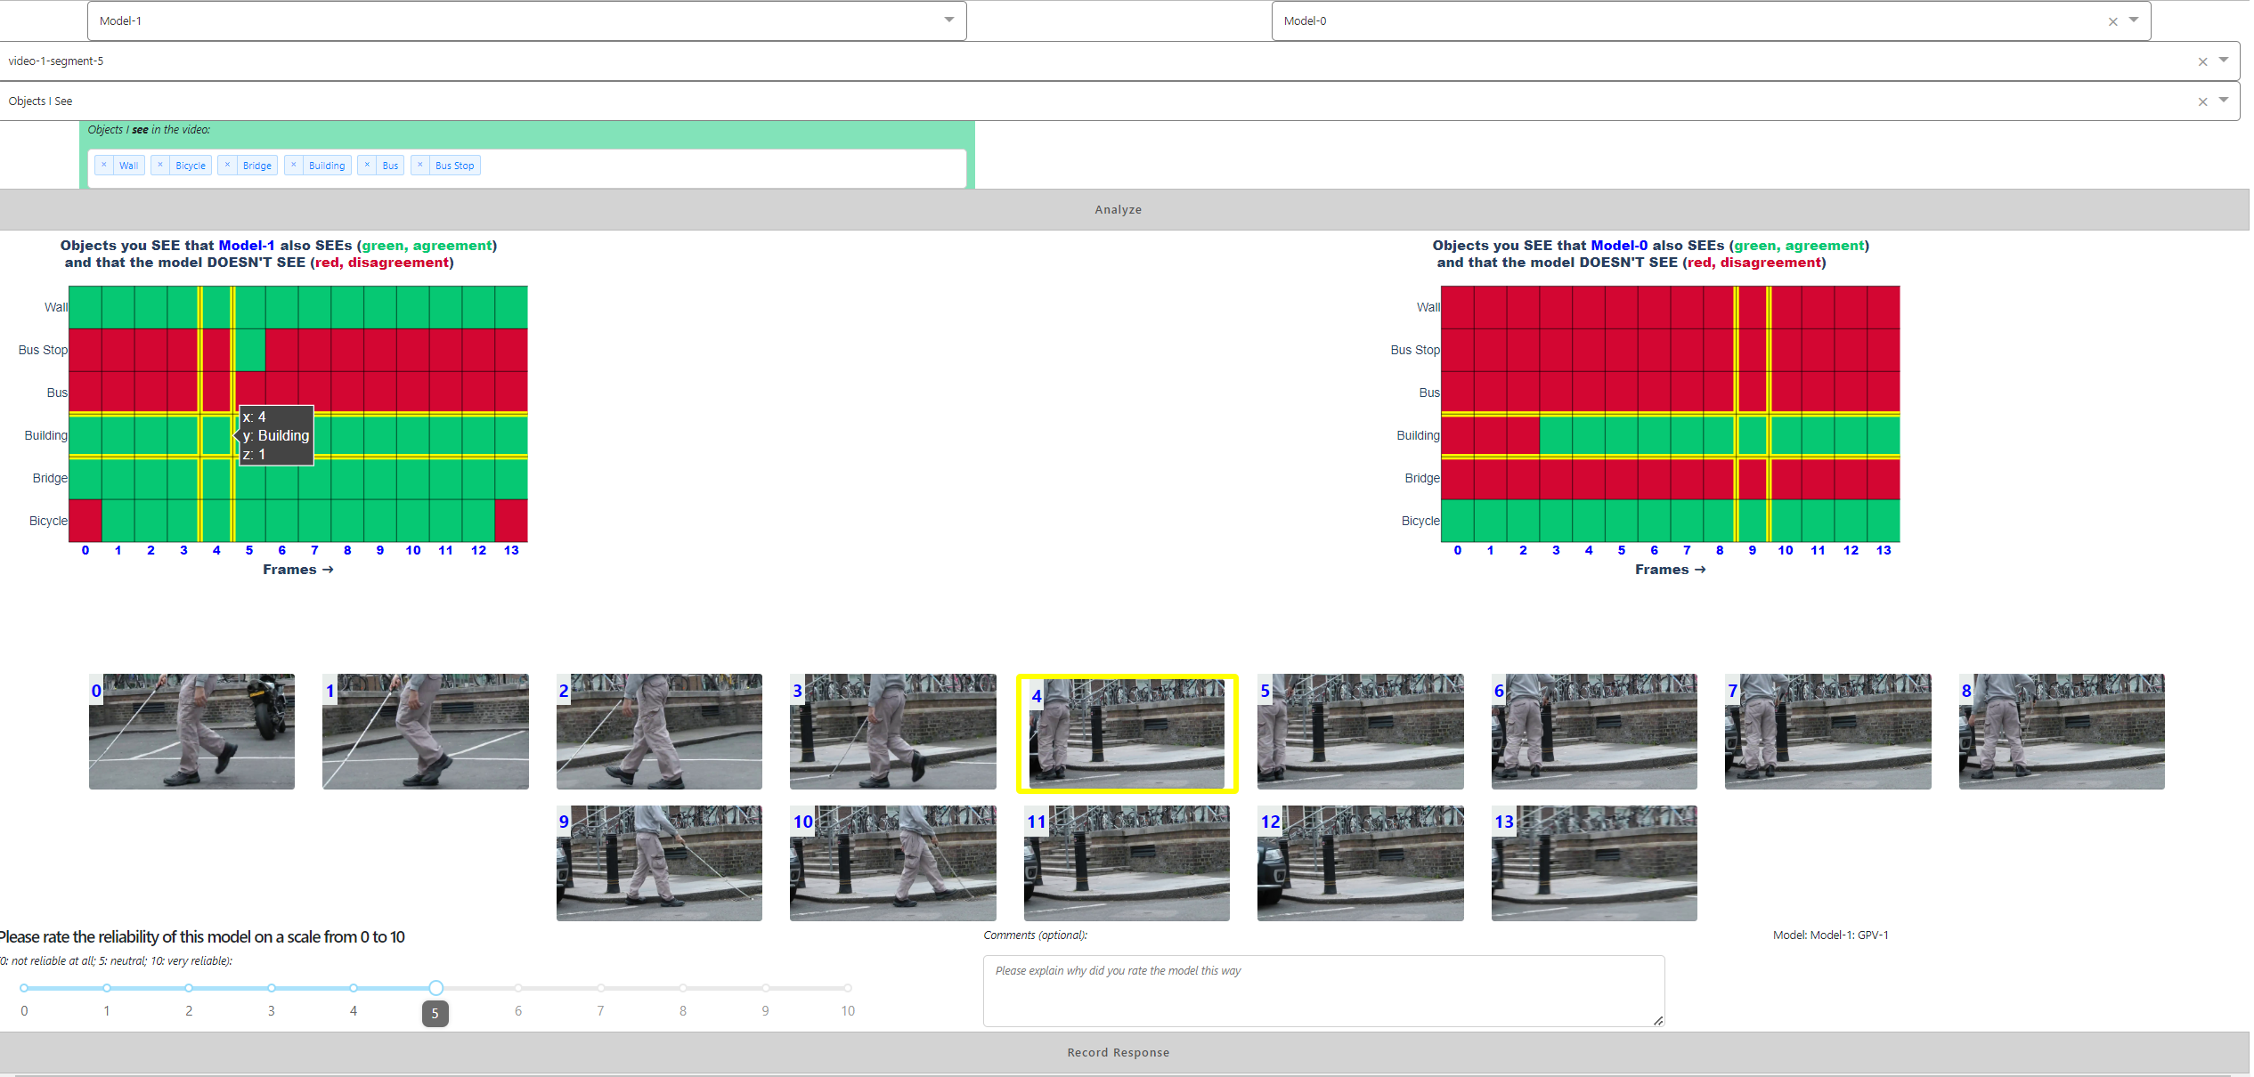

Slide 4
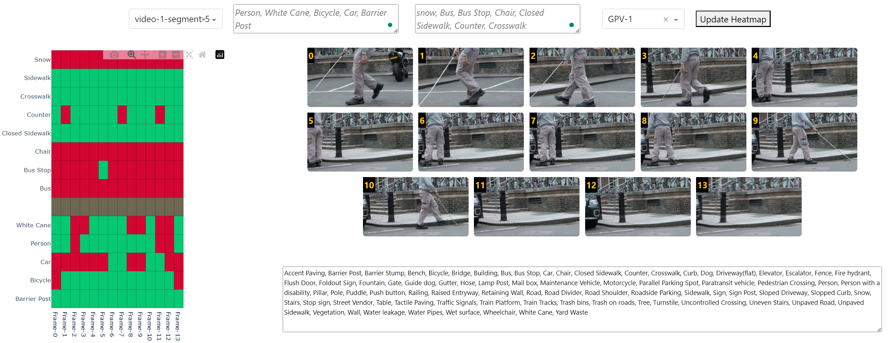

Slide 5
20
15
10
5
0
1
2
3
4
5
6
7
8
9
10

Slide 6
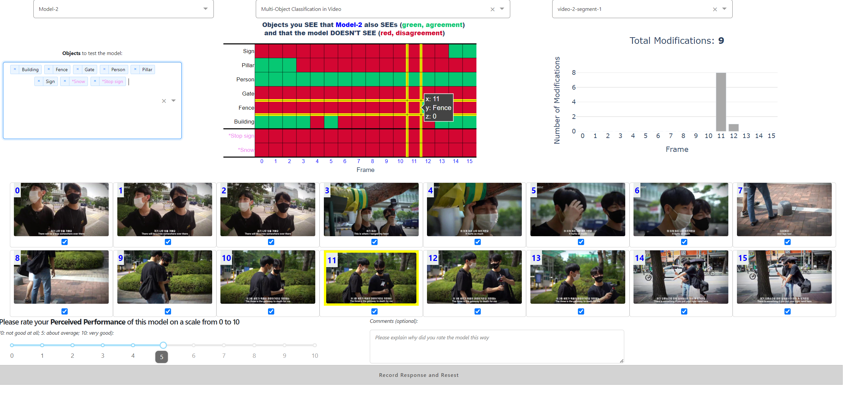

Slide 7
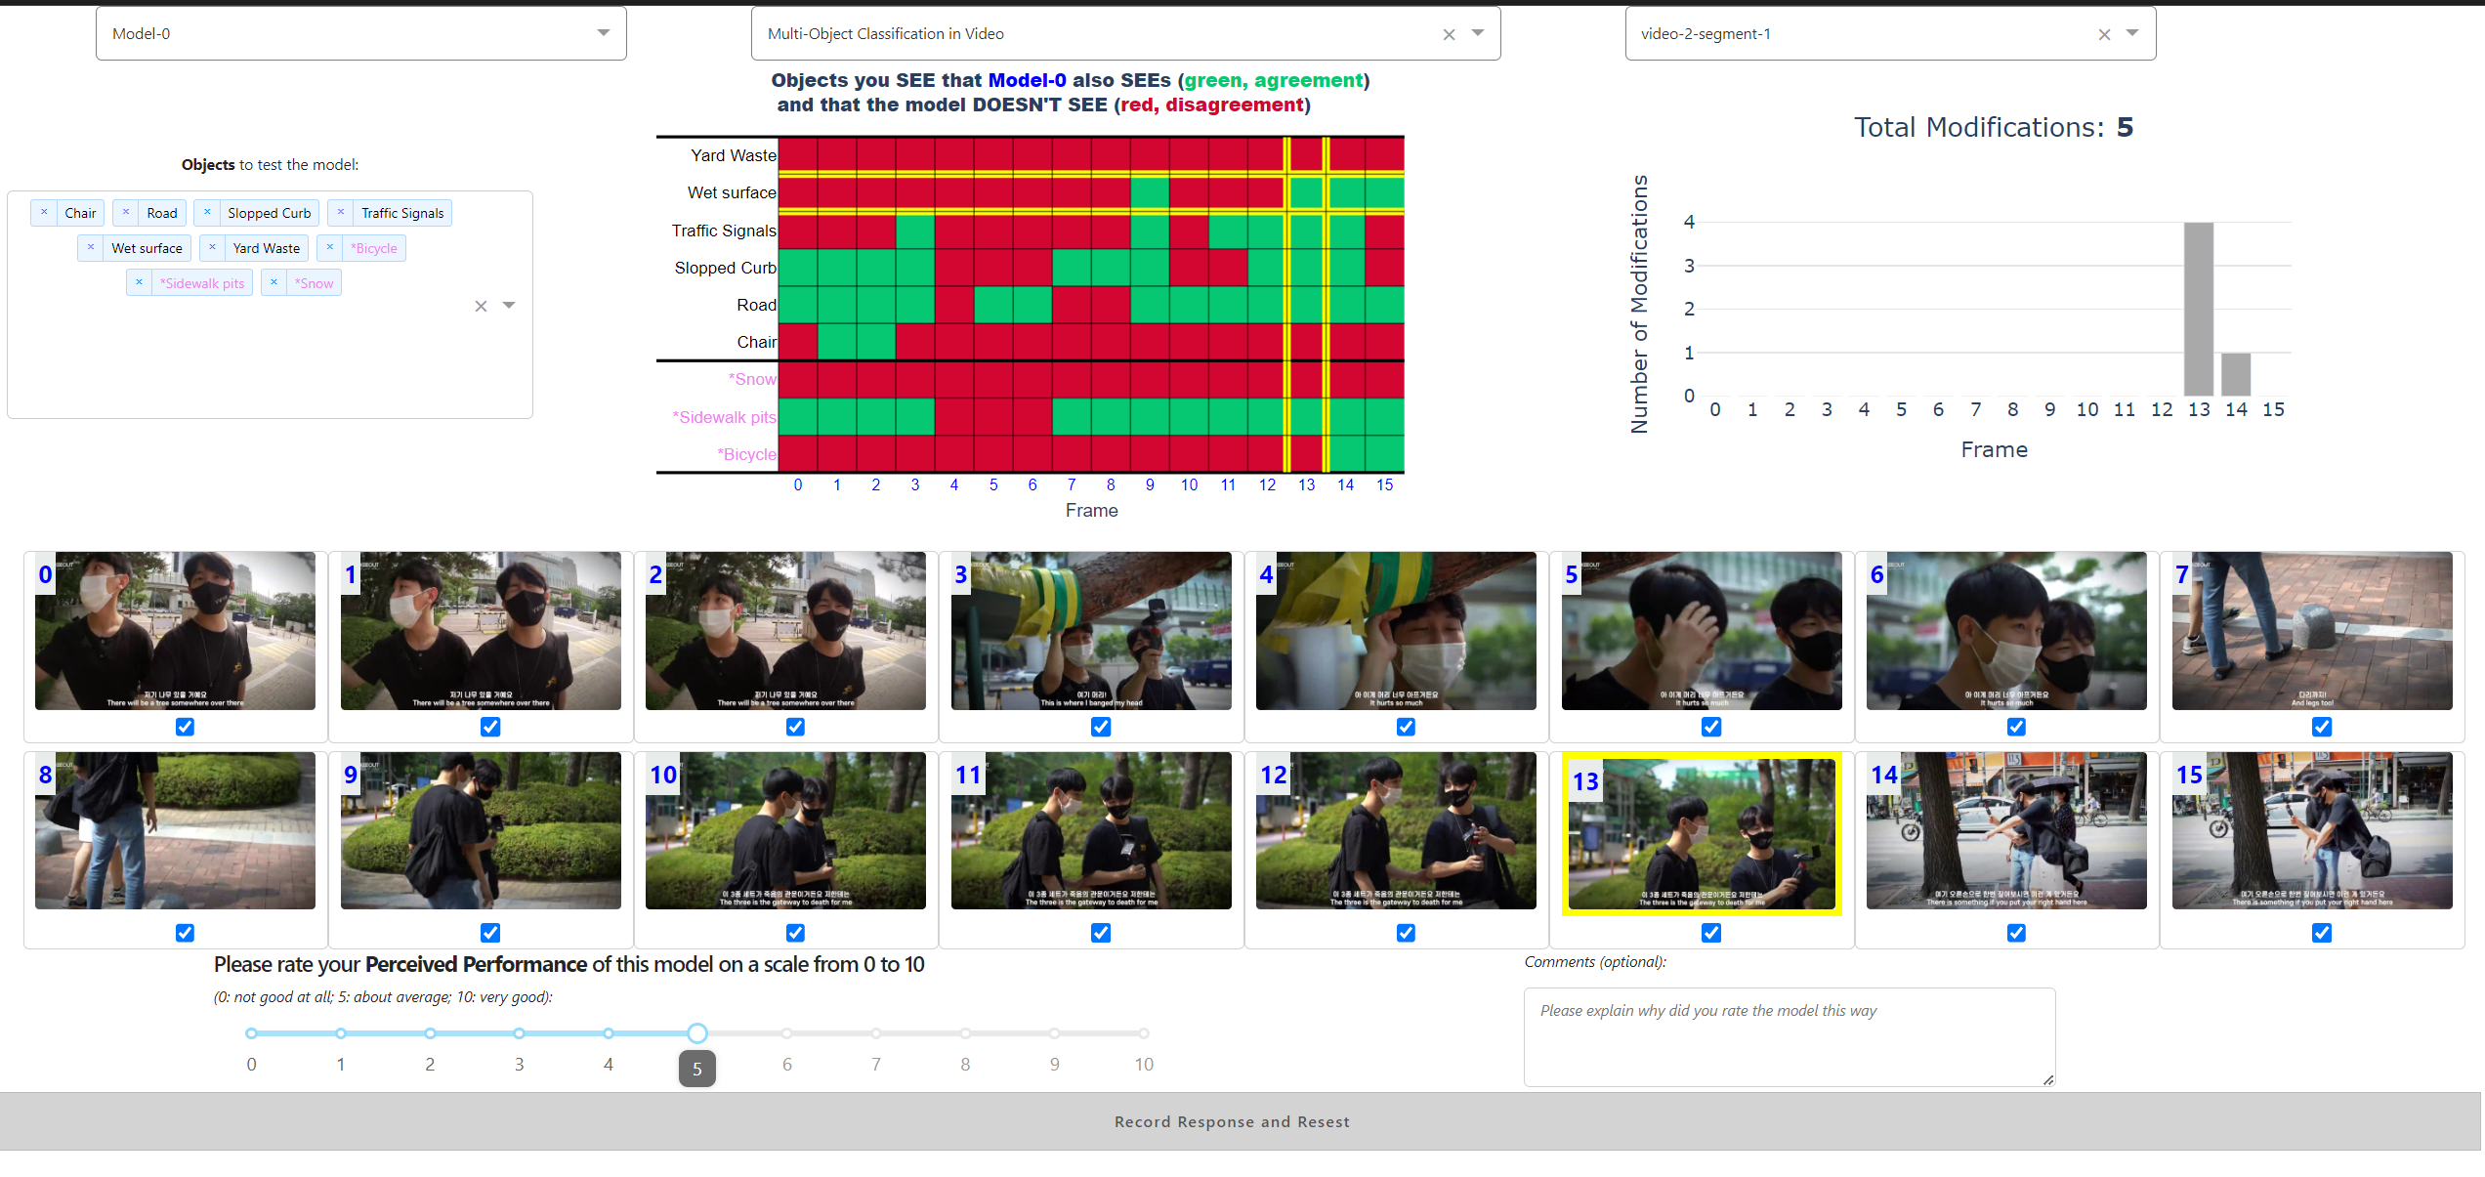

Slide 8
A
B
C
F
E
D
G
H
I
J

Slide 9
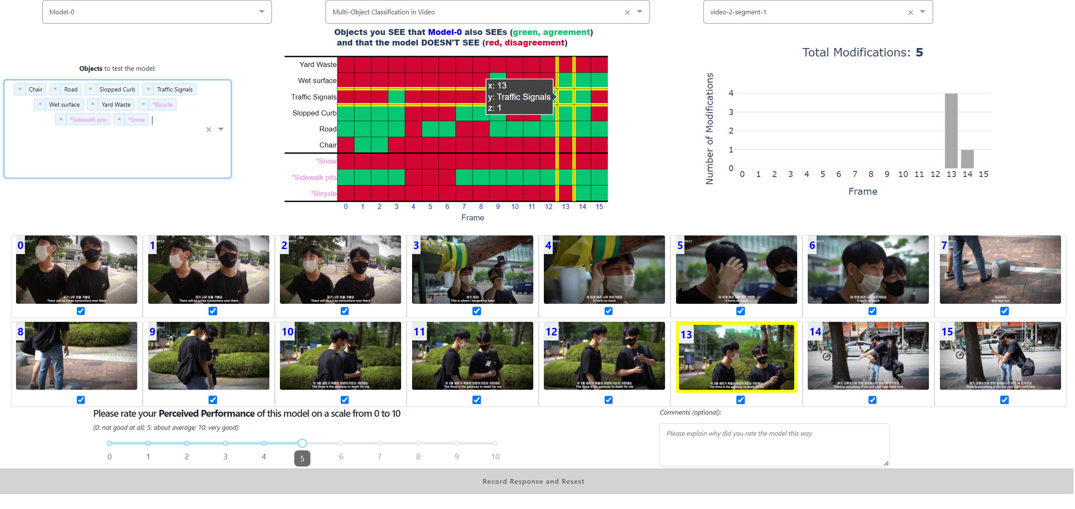
A
B
C
F
E
D
G
H
I
J

Slide 10
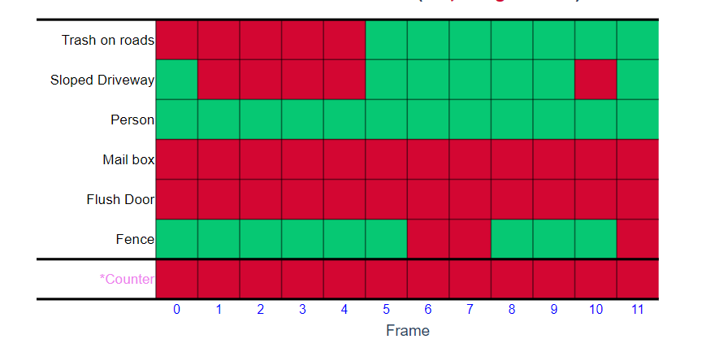
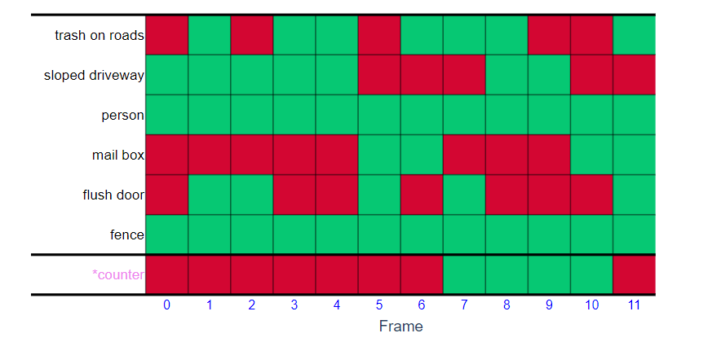
BLIP (F1 : 0.7385)
BLIP@Shadow (F1 : 0.7407)

Slide 11
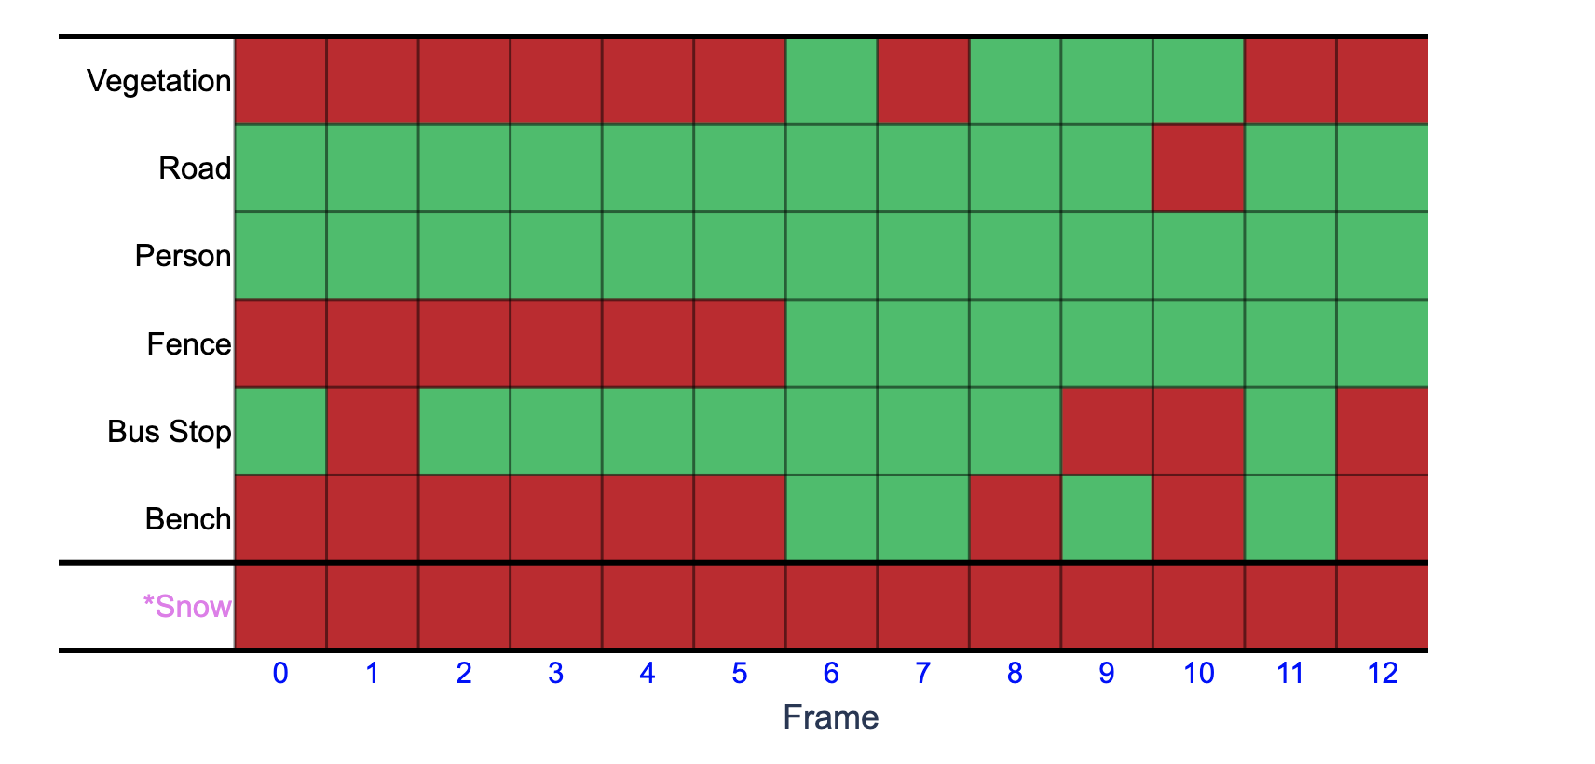

Slide 12
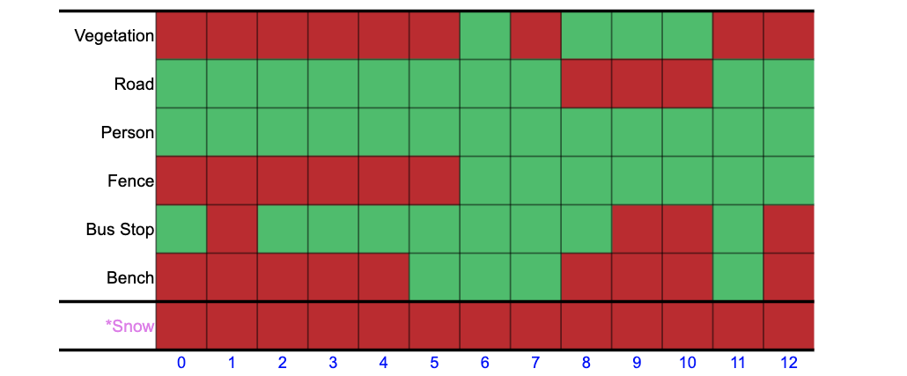
Uni-color Rows
Outlier Islands
Outliers

Slide 13
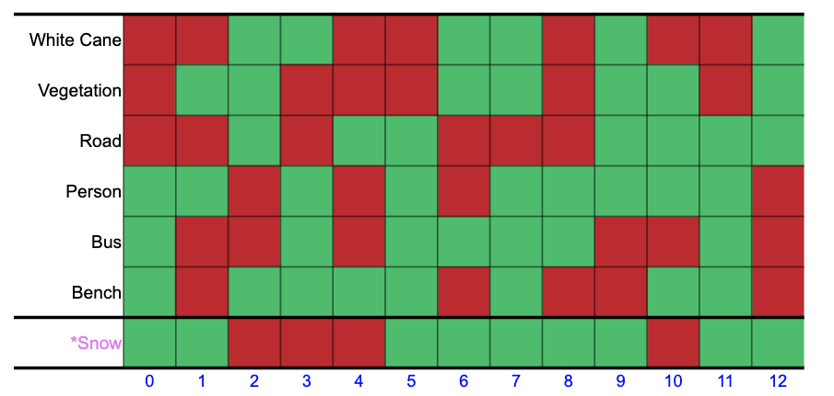

Slide 14
All Model Outputs
Model Output:
True
Correct Output:
True

Slide 15
All Predictions
True Negatives
(TN)
X
True Positives
(TP)
False Positives
(FP)
False Negatives
(FN)
X
Prediction:
Positive
Label:
True

